Slide 1
IBM
HaCk CHALLENGE
Problem Statement: METHOD TRACE ANALYSER
Team Members:
RAHUL KUMAR
VAIBHAV PALIWAL
SHRUTI AGARWAL
VISHAL TULSANI

Slide 2
FLOW DIAGRAM:
Running the same application can append the same log file.
END
START
A log file and and html based log files are generated in folder
Servlet_Session-1.2 →log→methodlogs.log
RIGHT CLICK ON PROJECT
“Servlet_Session-1.2”
A message showing “REGISTRATION SUCCESSFUL”
Click on RUN AS →Tomcat server
CORRECT
Enter the details required in the form
A localhost server opens the GUI based registration form in browser.
WRONG
A blank screen shows on the browser

Slide 3
Tracing
Tracing is a facility to redirect any output in the Java Console to a trace file.
Java Plug-in
Tracing can be turned on by enabling the property javaplugin.trace. However, it turns on all tracing facilities inside Java Plug-in. To enable more fine-grained tracing, javaplugin.trace.option may be used. You can set trace-level options (0-5) in the Java Console, shown in the previous chapter, with the following meanings:
0 — off
1 — basic
2 — network, cache, and basic
3 — security, network and basic
4 — extension, security, network and basic
5 — LiveConnect, extension, security, network, temp, and basic
This enables tracing on the fly.
Another way to set fine-grained tracing is through the Java Control Panel. For instance, to enable tracing for everthing (option 5 above), enter the following in the "Java Run Time Parameters" textfield:
-Djavaplugin.trace=true -Djavaplugin.trace.option=basic|net|cache|security|ext|liveconnect|temp
Tracing set through the Control Panel will take effect when the Plug-in is launched, but changes made through the Control Panel while a Plug-in is running will have no effect until restart.
Java Web Start
To set the initial trace level for a Java Web Start application, you can create a .javawsrc file in either your home directory or the jre/bin directory. This file can have entries:
TraceBasic=true TraceNetwork=true TraceSecurity=true TraceCache=true TraceExtensions=true TraceTemp=true

Slide 4
Logging
Similar to tracing, logging is a facility to redirect any output in the Java Console to a log file using the Java Logging API. Logging can be turned on by enabling the property javaplugin.logging:
-Djavaplugin.logging=true

Slide 5
Difference Between Logging and Tracing
﻿
Logging:
When you design a big application you need to have good and flexible error reporting perhaps across machines to collect log data in a centralized way. That is a perfect use case for the Logging Application Block where you configure some remote trace listener and send the log data to a central log server which stores its log messages in a database, log file or whatever. If you use out of process communication you are limited by the network performance already which is in the best case several thousand logs/s.
Tracing:
Besides Error Reporting you also need to trace your program flow to find out where the performance bottlenecks are and even more important when an error occurs you have a chance to find out how you did get there. In an ideal world every function would have some tracing enabled with the function duration, passed parameters and how far you did get in your function.

Slide 6
Why prefer Log4j over System.out.println
Many Java programmers have their own reason for using a logging framework like Log4j, java.util.Logger, SL4j or even Apache Commons logging, but they all are better than using the System.out.println(). Though my advice is to prefer SLF4j over Log4j for logging in Java as discussed in that article. Anyway, here are some of the reasons, which I think are enough to stop you using System.out.println() statements in production code:
Any logging framework including Log4j, SL4J, logback, and java.util.logger allows you to log debugging information with a log level, later you can use that level as filtering criteria, i.e. you can disable message belongs to one particular log level e.g. you would be more concerned to see WARN messages than DEBUG messages in production.
2) The second point, which is related to the previous one is that logging framework allows you to suppress message from another log level, for example, you can run your application in DEBUG mode in the test environment, but on ERROR mode in a production environment. This will not only generates fewer logs but also improves the performance of your application because of less logging, see 10 tips on logging in Java to learn more about this.
This is not possible with System.out.println() statements which can not be controlled by any configuration or dynamically at runtime using JMX or any watchdog facility. On the other hand, you can change the log level for log4j based logger without restarting your application by using a watchdog thread, which monitors a location for updated log4j.xml, the configuration file for Apache Log4j. The java.util.Logger also allows you to change logging level using JMX without restarting the server.
3) By using a Logging framework, you can produce better outputs and metadata, which will help during troubleshooting and debug. Most logging framework e.g. Log4j allows you to print formatted output by specifying a formatting pattern by using PatterLayout, which can include a timestamp, name of the class, the Thread which is executing code etc. All of this information can be really useful while debugging concurrent applications where the output from multiple threads is overlapping. You don't get this facilities when you use the System.out.println() statements for logging messages. What more, eve Joshua Bloch has also suggested using a properly logging facility e.g. java.util.Logger for logging in his classic book Effective Java, one of the must-read books for experienced Java programmers. Using System.out or System.err rather than a dedicated logging facility makes it difficult to monitor the behavior of the program.

Slide 7
Example : The first Java program that a developer learns to write often looks like this:
public class MyClass public static void main(String[] args) { System.out.println("hello world"); } }
While most programmers go on to learn many nuances and subtleties about Java, a surprising number hang on to this first lesson and never give up on writing messages to standard output using System.out.println() statement. Well, this is Ok if you are writing small test programs but it certainly not right if you coding on a production system live with millions of users or trades.
Logging also affects performance in a big way, I have seen a live example where support team left the production system on DEBUG level only to find the latency shoots up by 500 ms and users complaining about delayed execution. That's all about why a Java programmer should use a Logging framework over System.out.println() statement in production code. As I said, it's perfectly Ok if you are writing test programs and small application but it's not Ok in your real-world Java application. You might know that you can also use Log4j without XML configuration or property files , if that will encourage you to use it over print() statements. Though, formatted output with metadata, controlling log level at runtime are some of the features you certainly don't want to ignore.

Slide 8
LOG4 J Methods:
Logger class provides a variety of methods to handle logging activities. The Logger class does not allow us to instantiate a new Logger instance but it provides two static methods for obtaining a Logger object −
public static Logger getRootLogger();
public static Logger getLogger(String name);
The first of the two methods returns the application instance's root logger and it does not have a name.
Any other named Logger object instance is obtained through the second method by passing the name of the logger. The name of the logger can be any string you can pass, usually a class or a package name as we have used in the last chapter and it is mentioned below −
static Logger log = Logger.getLogger(log4jExample.class.getName());
Once we obtain an instance of a named logger, we can use several methods of the logger to log messages. The Logger class has the following methods for printing the logging information.
# | Methods and Description
1 | public void debug(Object message):-It prints messages with the level Level.DEBUG.
2 | public void error(Object message):-It prints messages with the level Level.ERROR.
3 | public void fatal(Object message):-It prints messages with the level Level.FATAL.
4 | public void info(Object message):-It prints messages with the level Level.INFO.
5 | public void warn(Object message):-It prints messages with the level Level.WARN.
6 | public void trace(Object message):-It prints messages with the level Level.TRACE.

Slide 9
All the levels are defined in the org.apache.log4j.Level class and any of the above mentioned methods can be called as follows −
import org.apache.log4j.Logger;
public class LogClass {
private static org.apache.log4j.Logger log = Logger.getLogger(LogClass.class);
public static void main(String[] args) {
log.trace("Trace Message!");
log.debug("Debug Message!");
log.info("Info Message!");
log.warn("Warn Message!");
log.error("Error Message!");
log.fatal("Fatal Message!"); } }
When you compile and run LogClass program, it would generate the following result −
Debug Message!
Info Message!
Warn Message!
Error Message!
Fatal Message!
All the debug messages make more sense when they are used in combination with levels. We will cover levels in the next chapter and then, you would have a good understanding of how to use these methods in combination with different levels of debugging.

Slide 10
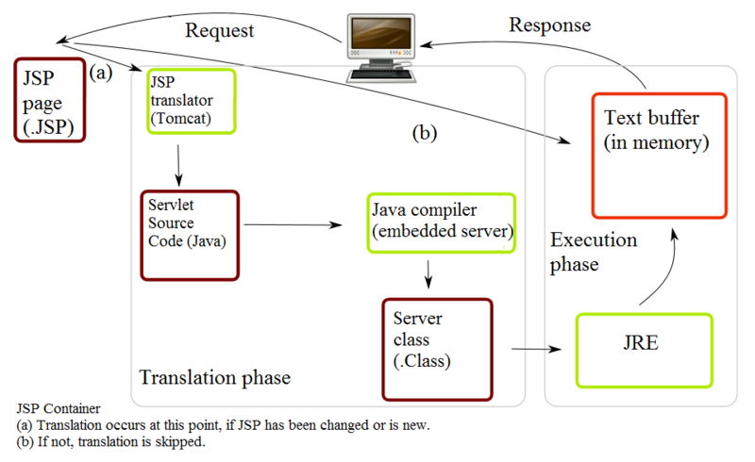
What is java servlet ?
A Java servlet processes or stores a Java class in Java EE that conforms to the Java Servlet API,^{[1]} a standard for implementing Java classes that respond to requests. Servlets could in principle communicate over any client–server protocol, but they are most often used with the HTTP. Thus "servlet" is often used as shorthand for "HTTP servlet".^{[2]} Thus, a software developer may use a servlet to add dynamic content to a web server using the Java platform. The generated content is commonly HTML, but may be other data such as XML and more commonly, JSON. Servlets can maintain state in session variables across many server transactions by using HTTP cookies, or URL mapping.

Slide 11
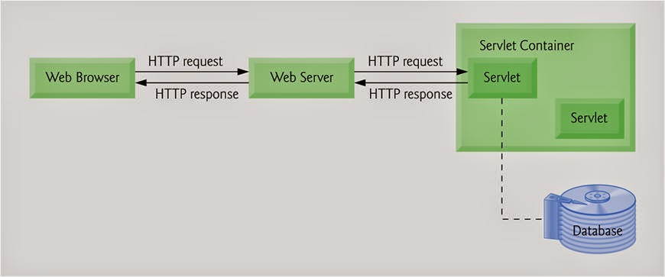
Servelet:
--module run inside request/reponse-oriented system.

Slide 12
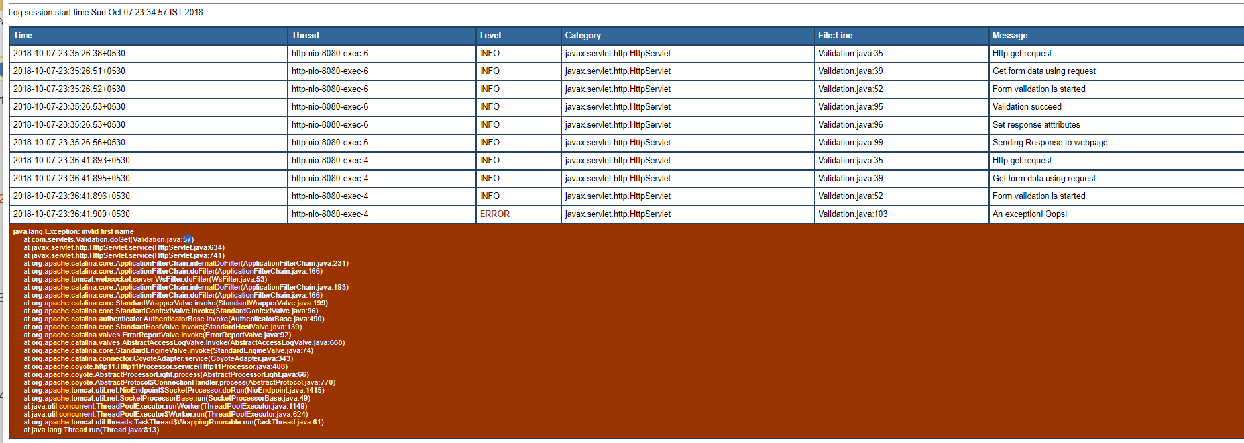
TABULAR ANALYSIS OF METHODS:

Slide 13
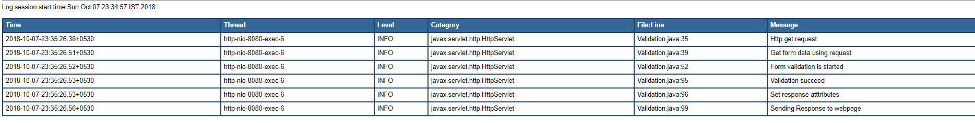

Slide 14


